Slide 1
COMPUTER ORGANIZATION & ARCHITECTURE

Slide 2
Unit-2
Register Transfer and Microoperations

Slide 3
Register Transfer and Microoperations
» Register Transfer Language (RTL)
» Register Transfer
» Bus and Memory Transfers
» Arithmetic Microoperations
» Logic Microoperations
» Shift Microoperations
» Arithmetic Logic Shift Unit

Slide 4
Register Transfer Language (RTL)
Register Transfer Language
Register Transfer Language (RTL) is a symbolic notation used to describe micro-operation transfers between registers in computer systems.
1. Micro-operations: The operation on the data in registers are called Micro-operations.
2.Register Transfer: It represents the transformation of information from one register to another.
For example, the statement R2 <- R1 denotes transferring the content of register R1 into register R2.
3.Basic Symbols of RTL:
a) Register Names: Denoted by letters and numbers (e.g., MAR, R1, R2).
b) Part of Register: Represented as (8-bit) to denote a specific portion of a register (e.g., R1 (0-7)).
c) Transfer Operator: The <- symbol indicates information transfer (e.g., R2 <- R1).
d) Conditional Operations: Conditional transfers based on a condition (e.g., P : R2 <- R1 if P=1).
e) Naming Operator: Denotes an alias for an existing register (e.g., Ra := R1).

Slide 5
Register Transfer
DESIGNATION OF REGISTERS
Registers are designated by capital letters, sometimes followed by numbers
(e.g., A, R13, IR)
Often the names indicate function:
MAR - Memory Address Register
PC - Program Counter
IR - Instruction Register
AR - Address Register
Registers and their contents can be viewed and represented in various ways
A register can be viewed as a single entity:
MAR

Slide 6
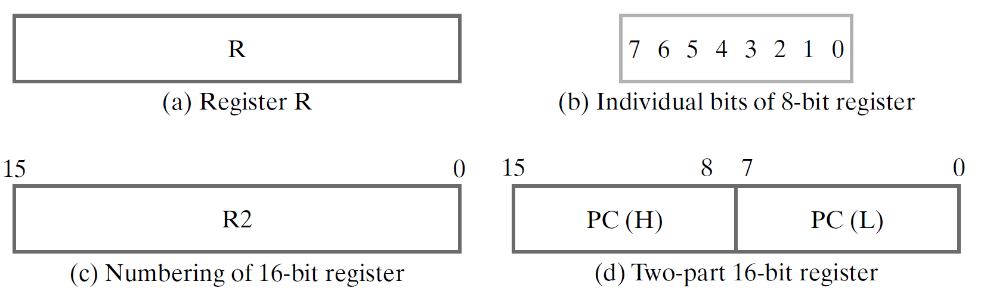
Register Transfer
Registers may also be represented showing the bits of data they contain
Designation of a register
- a register
- portion of a register
- a bit of a register
Common ways of drawing the block diagram of a register

Slide 7
Register Transfer
Copying the contents of one register to another is a register transfer
A register transfer is indicated as R2 ← R1
In this case the contents of register R1 are copied (loaded) into register R2.
A simultaneous transfer of all bits from the source R1 to the destination register R2, during one clock pulse.
Note that this is a non-destructive; i.e. the contents of R1 are not altered by copying (loading) them to R2.

Slide 8
Register Transfer
Symbols | Description | Examples
Capital letters & numerals | Denotes a register | MAR, R2
Parentheses () | Denotes a part of a register | R2(0-7), R2(L)
Arrow ← | Denotes transfer of information | R2 ← R1
Colon : | Denotes termination of control function | P:
Comma , | Separates two micro-operations | A ← B, B ← A

Slide 9
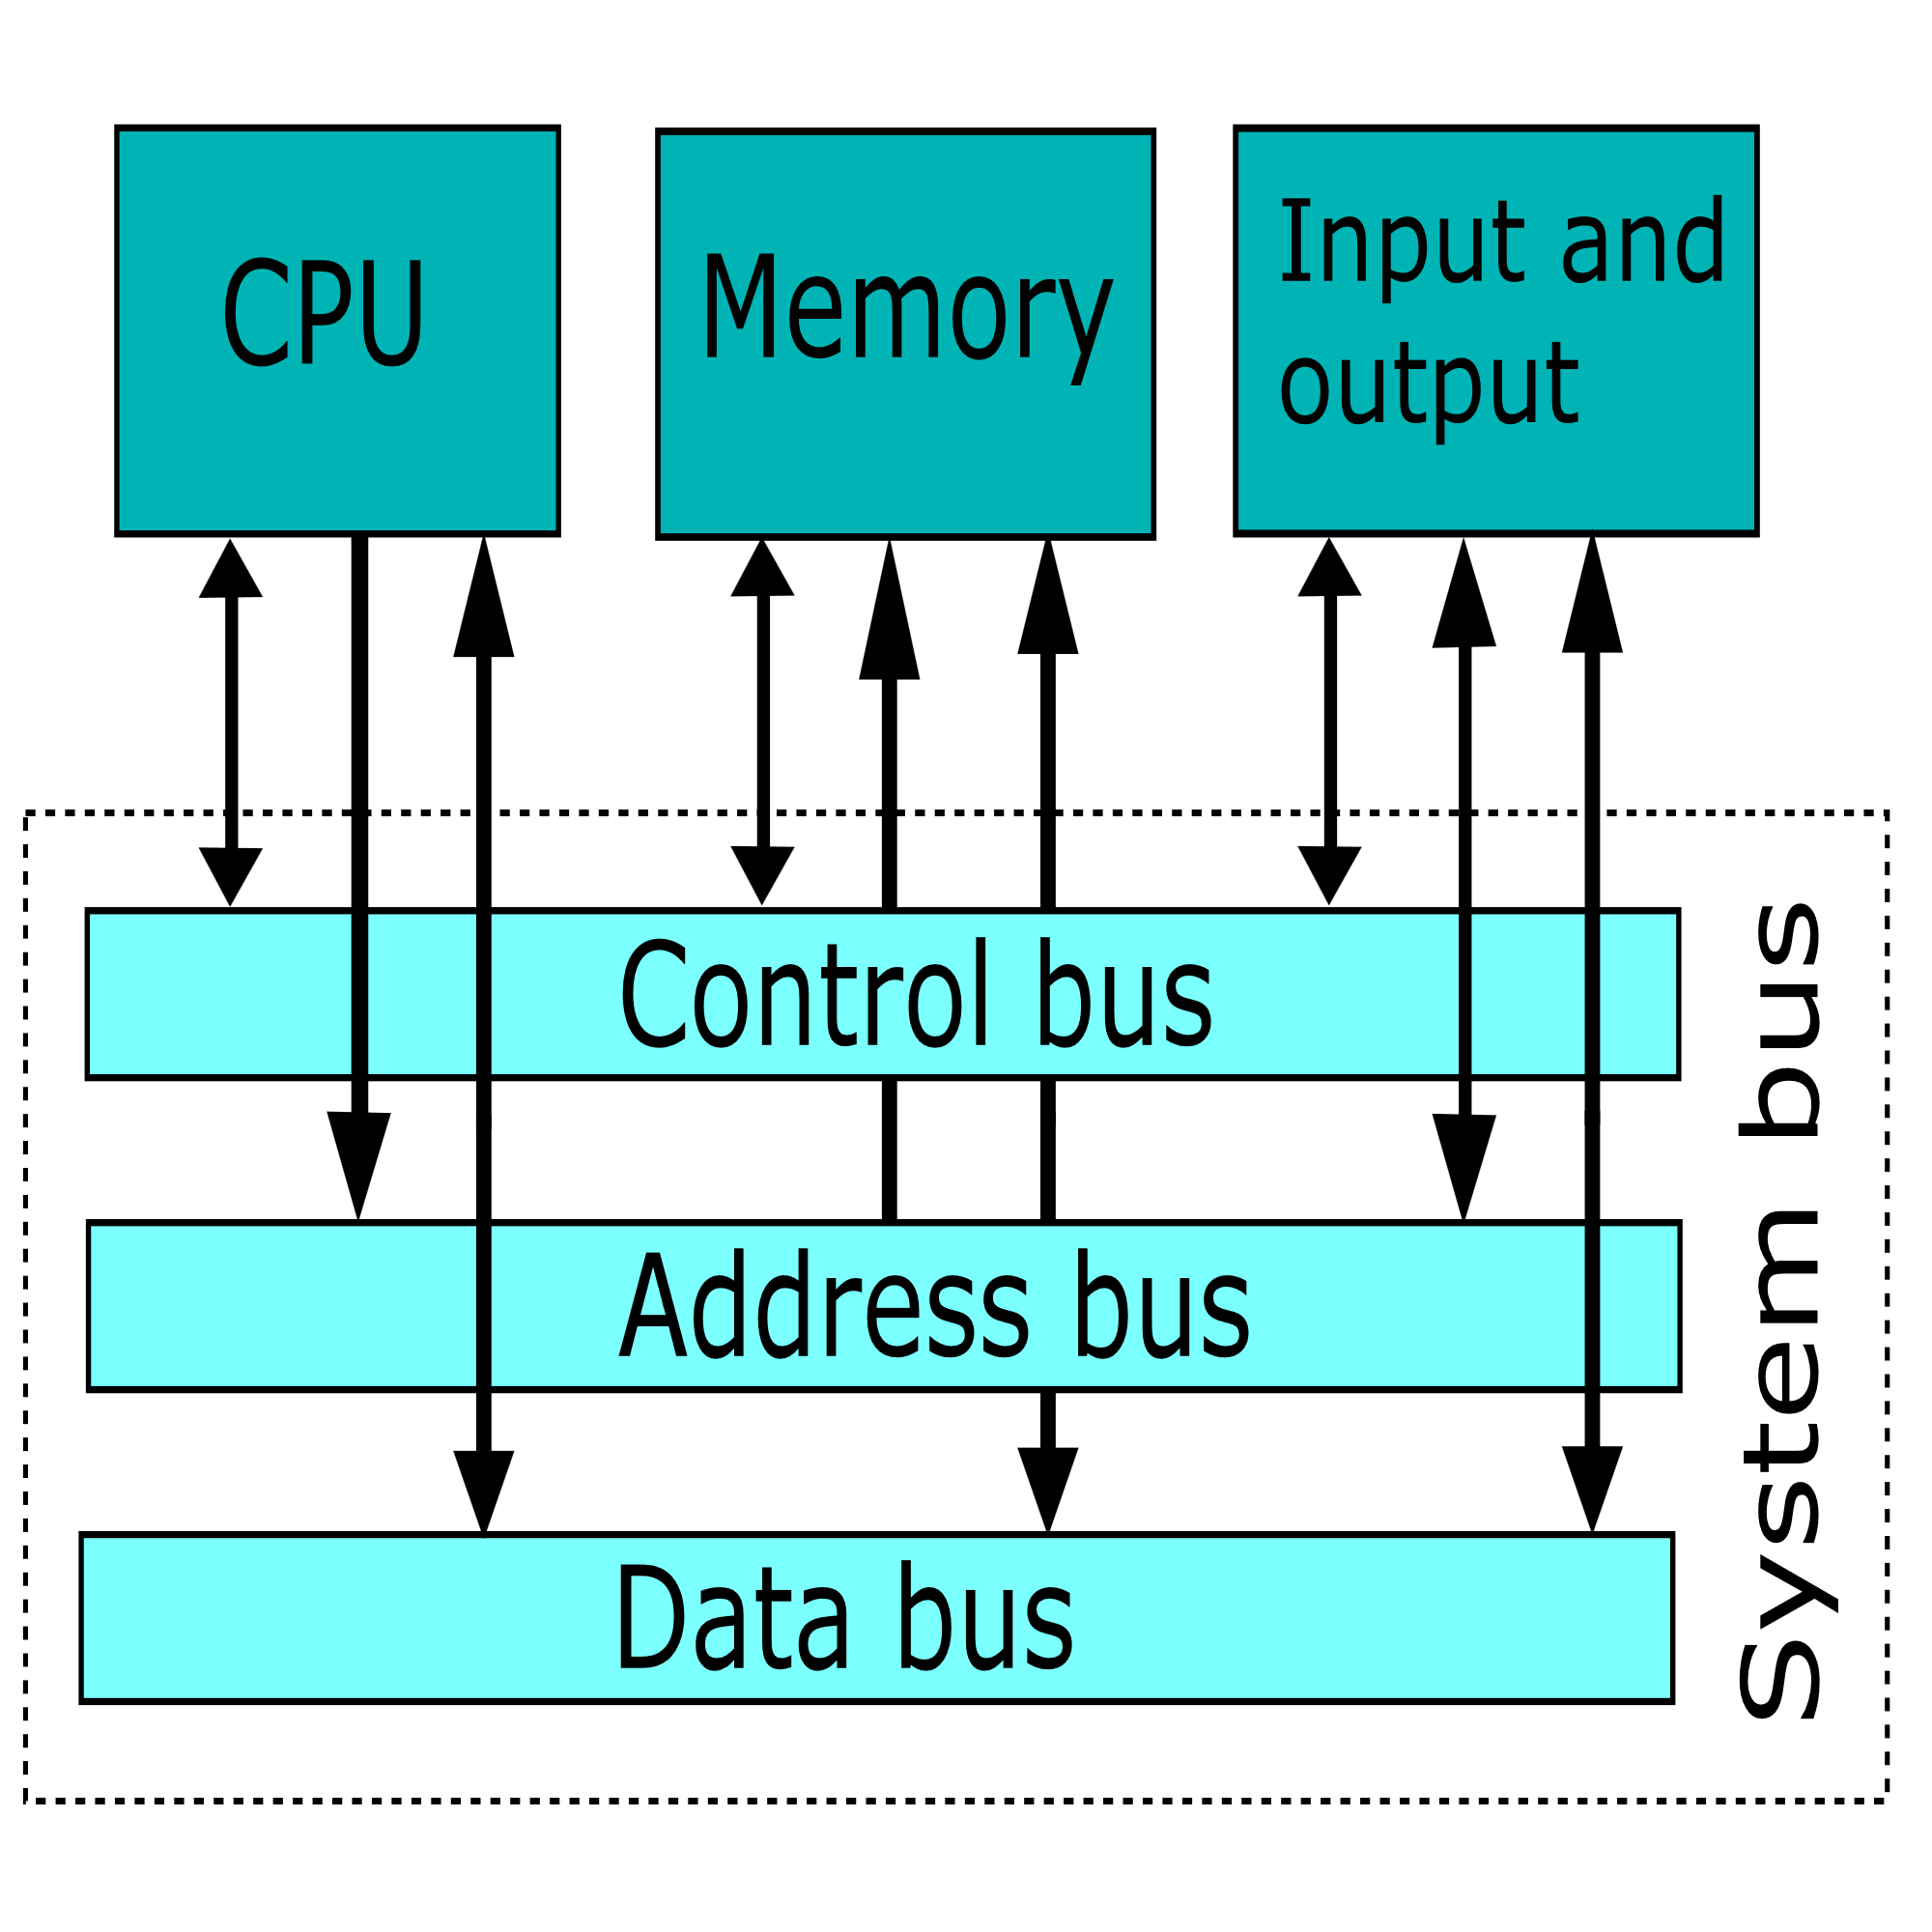
COMMON BUS STRUCTURE

Slide 10
Bus and Memory Transfer
* A more efficient scheme for transferring information between registers in a multiple-register configuration is a Common Bus System.
* A common bus consists of a set of common lines, one for each bit of a register.
* Control signals determine which register is selected by the bus during each particular register transfer.
➢ Different ways of constructing a Common Bus System
✓1) Using Multiplexers
✓2) Using Tri-state Buffers

Slide 11
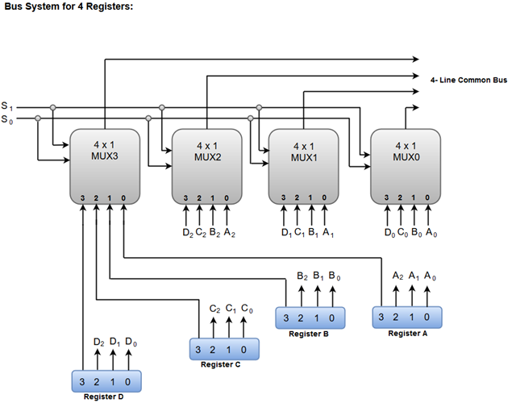
Bus and Memory Transfer
Common bus system is with multiplexers:
➢ The multiplexers select the source register whose binary information is then placed on the bus.

Slide 12
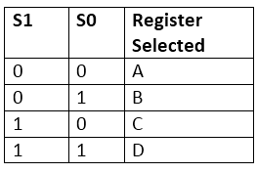
Bus and Memory Transfer
When both of the select lines are at low logic, i.e. S1S0 = 00, the 0 data inputs of all four multiplexers are selected and applied to the outputs that forms the bus. This, in turn, causes the bus lines to receive the content of register A since the outputs of this register are connected to the 0 data inputs of the multiplexers.
Similarly, when S1S0 = 01, register B is selected, and the bus lines will receive the content provided by register B.

Slide 13
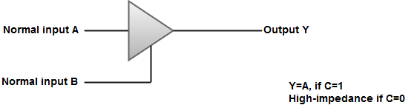
A bus system can also be constructed using three-state gates instead of multiplexers.
The most commonly used three state gates in case of the bus system is a buffer gate.
The graphical symbol of a three-state buffer gate can be represented as:

Slide 14
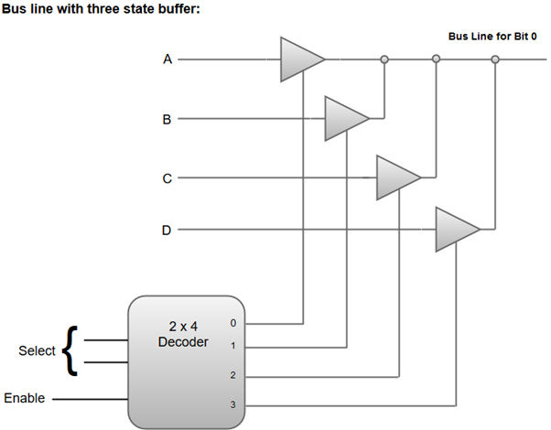

Slide 15
Memory Transfer
Memory Transfer
Most of the standard notations used for specifying operations on memory transfer are stated below.
The transfer of information from a memory unit to the user end is called a Read operation.
The transfer of new information to be stored in the memory is called a Write operation.
A memory word is designated by the letter M.
We must specify the address of memory word while writing the memory transfer operations.
The address register is designated by AR and the data register by DR.
Thus, a read and write operation can be stated as:

Slide 16
Memory Transfer
Read: DR ← M [AR]
Write: M [AR] ← R1
200
Address
Data
300
Control
400
ALU
Control Unit
500
Processor
Memory

Slide 17
Arithmetic Micro-operations
Arithmetic Micro-operations
In general, the Arithmetic Micro-operations deals with the operations performed on numeric data stored in the registers.
The basic Arithmetic Micro-operations are classified in the following categories:
1) Addition
2) Subtraction
3) Increment
4) Decrement
5) Shift
Some additional Arithmetic Micro-operations are classified as:
1) Add with carry
2) Subtract with borrow
3) Transfer/Load, etc.

Slide 18
Symbolic Representation Description
R3 ← R1 + R2 The contents of R1 plus R2 are transferred to R3.
R3 ← R1 - R2 The contents of R1 minus R2 are transferred to R3
R2 ← R2' Complement the contents of R2 (1's complement)
R2 ← R2' + 1 2's complement the contents of R2 (negate)
R3 ← R1 + R2' + 1 R1 plus the 2's complement of R2 (subtraction)
R1 ← R1 + 1 Increment the contents of R1 by one
R1 ← R1 - 1 Decrement the contents of R1 by one

Slide 19
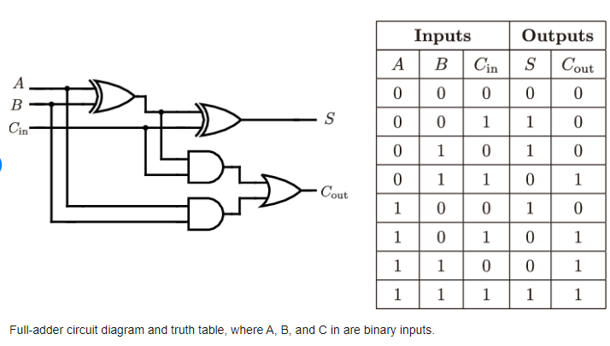

Slide 20
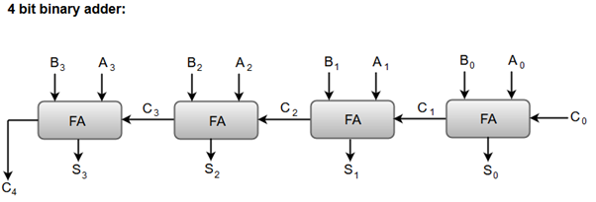
Binary Adder
Binary Adder
The Add micro-operation requires registers that can hold the data and the digital components that can perform the arithmetic addition.
A Binary Adder is a digital circuit that performs the arithmetic sum of two binary numbers provided with any length.
A Binary Adder is constructed using full-adder circuits connected in series, with the output carry from one full-adder connected to the input carry of the next full-adder.

Slide 21
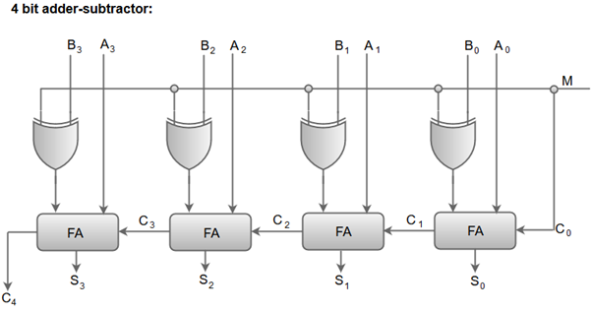
Binary Adder-Subtractor
Binary Adder-Subtractor
The Subtraction micro-operation can be done easily by taking the 2's compliment of addend bits and adding it to the augend bits.
The Arithmetic micro-operations like addition and subtraction can be combined into one common circuit by including an exclusive-OR gate with each full adder.

Slide 22
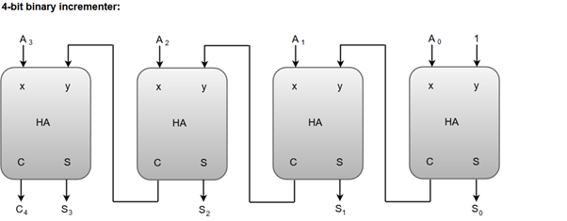
Binary Incrementer
Binary Incrementer
The increment micro-operation adds one binary value to the value of binary variables stored in a register. For instance, a 4-bit register has a binary value 0110, when incremented by one the value becomes 0111.
The increment micro-operation is best implemented by a 4-bit combinational circuit incrementer.

Slide 23
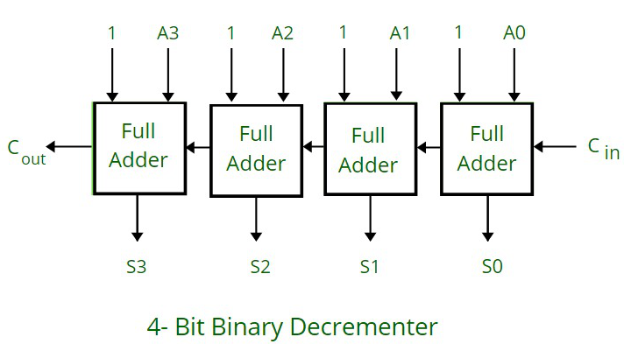
Binary Decrementer
Binary Decrementer
It subtracts 1 binary value from the existing binary value stored in the register or in other words we can simply say that it decreases the existing value stored in the register by 1.

Slide 24
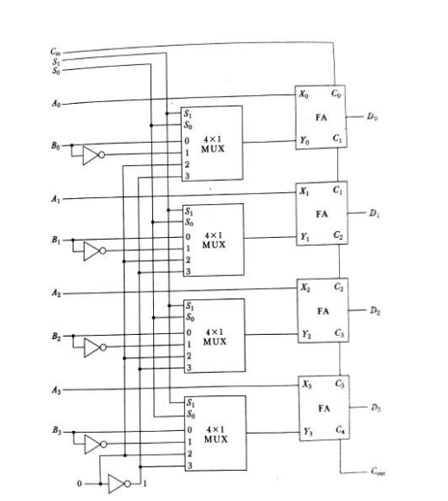
Arithmetic Circuit
Arithmetic Circuit

Slide 25
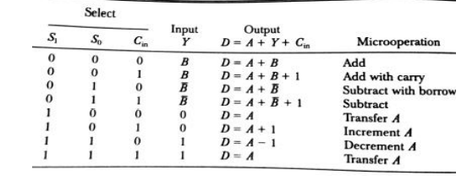
Arithmetic Circuit

Slide 26
Logic Micro-operations:
Logic Micro-operations:
Logic micro operations specify binary operations for strings of bits stored in registers.
These operations consider each bit of the register separately and treat them as binary variables.
For example, the exclusive-OR micro operation with the contents of two registers RI and R2 is
symbolized by the statement
It specifies a logic micro operation to be executed on the individual bits of the registers provided
that the control variable P = 1.
List of Logic Micro operations:
There are 16 different logic operations that can be performed with two binary variables.

Slide 27
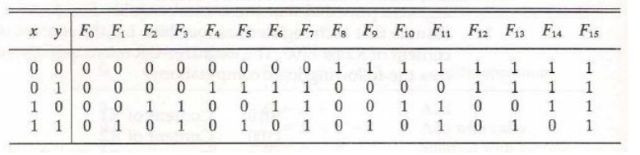

Slide 28
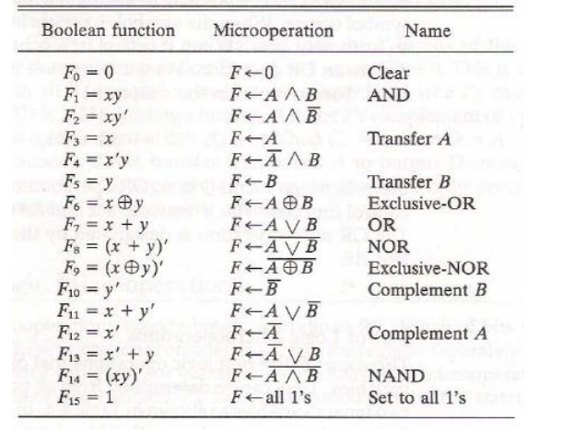

Slide 29
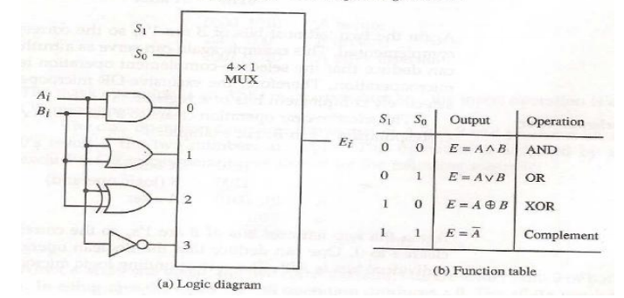

Slide 30

Applications:
1) Selective set
2) Selective complement
3) Selective clear
4) Mask
5) Insert
✓
6) Clear
selective-set
The selective-set operation sets to 1 the bits in register A where there are
corresponding l's in register B. It does not affect bit positions that have 0's in B. The following
numerical example clarifies this operation:
The OR microoperation can be used to selectively set bits of a register.

Slide 31

Selective complement
The selective-complement operation complements bits in A where there are corresponding
1's in B. It does not affect bit positions that have 0's in B. For example:
The exclusive-OR micro operation can be used to selectively complement bits of a register.

Slide 32


Selective clear
The selective-clear operation clears to 0 the bits in A only where there are
corresponding l's in B. For example:
Mask
The mask operation is similar to the selective-clear operation except that the bits of A are cleared
only where there are corresponding O's in B . The mask operation is an AND micro operation as
seen from the following numerical example:

Slide 33
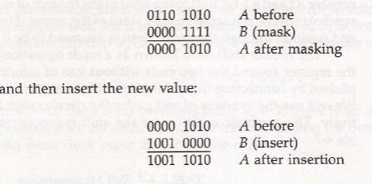
Insert
The insert operation inserts a new value into a group of bits. This is done by first masking the bits
and then ORing them with the required value.
For example, suppose that an A register contains eight bits, 0110 1010. To replace the four leftmost
bits by the value 1001 we first mask the four unwanted bits:

Slide 34

Clear
The clear operation compares the words in A and B and produces an all 0's result if the two
numbers are equal. This operation is achieved by an exclusive-OR microoperation as shown
by the following example

Slide 35
Shift Microoperations:
Shift Microoperations:
1) Shift micro operations are used for serial transfer of data.
2) The contents of a register can be shifted to the left or the right.
3) During a shift-left operation the serial input transfers a bit into the rightmost position.
4) During a shift-right operation the serial input transfers a bit into the leftmost position.
5) There are three types of shifts:
I) logical
II) circular
III) arithmetic

Slide 36
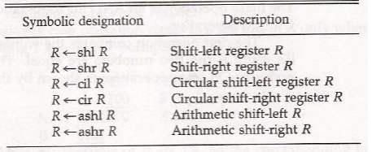
Logical Shift:
A logical shift is one that transfers 0 through the serial input.
The symbols shl and shr for logical shift-left and shift-right micro operations.
The bit transferred to the end position through the serial input is assumed to be 0 during a logical shift.

Slide 37
Circular Shift:
The circular shift (also known as a rotate operation) circulates the bits of the register around the two ends without loss of information.
This is accomplished by connecting the serial output of the shift register to its serial input.
We will use the symbols cil and cir for the circular shift left and right, respectively.
Arithmetic Shift:
An arithmetic shift is a micro operation that shifts a signed binary number to the left or right.
An arithmetic shift-left multiplies a signed binary number by 2.
An arithmetic shift-right divides the number by 2.
Arithmetic shifts must leave the sign bit unchanged because the sign of the number remains the same when it is multiplied or divided by 2.

Slide 38
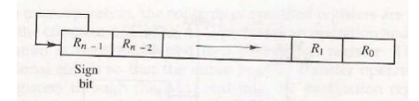
Hardware Implementation:
A combinational circuit shifter can be constructed with multiplexers.
The 4-bit shifter has four data inputs, A0 through A3, and four data outputs, H0 through H3.
There are two serial inputs, one for shift left (IL) and the other for shift right (IR).
When the selection input S=0 the input data are shifted right (down in the diagram).
When S = 1, the input data are shifted left (up in the diagram).
A shifter with n data inputs and outputs requires n multiplexers.
The two serial inputs can be controlled by another multiplexer to provide the three possible types of shifts.

Slide 39
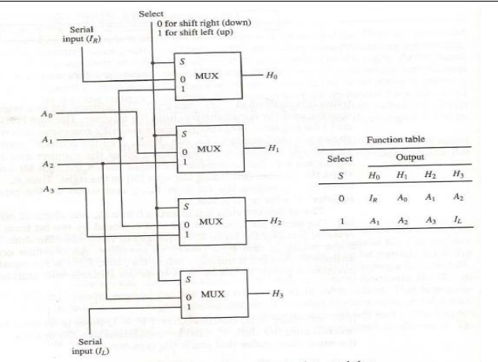

Slide 40
Arithmetic Logic Shift Unit
Arithmetic Logic Shift Unit
Instead of having individual registers performing the micro operations directly, computer systems employ a number of storage registers connected to a common operational unit called an arithmetic logic unit, abbreviated ALU.
The ALU is a combinational circuit so that the entire register transfer operation from the source registers through the ALU and into the destination register can be performed during one clock pulse period.
The shift micro operations are often performed in a separate unit, but sometimes the shift unit is made part of the overall ALU.
Particular micro operation is selected with inputs S1 and S0. A 4 x 1 multiplexer at the output chooses between an arithmetic output in Di and a logic output in Ei .
The data in the multiplexer are selected with inputs S3 and S2. The other two data inputs to the multiplexer receive inputs Ai-1 for the shift-right operation and Ai+1 for the shift-left operation.

Slide 41
The circuit whose one stage is specified provides eight arithmetic operation, four logic operations, and two shift operations.
Each operation is selected with the five variables S3, S2, S1, S0 and Cin.
The input carry Cin is used for selecting an arithmetic operation only.
The first eight are arithmetic operations and are selected with S3S2 = 00.
The next four are logic and are selected with S3S2 = 01.
The input carry has no effect during the logic operations and is marked with don't-care x’s.
The last two operations are shift operations and are selected with S3S2= 10 and 11.
The other three selection inputs have no effect on the shift.

Slide 42
